Slide 1
Locked & Loaded
Locked in code.
Loaded implications.
Open Closed Principle.

Slide 2
ABOUT ME – Brett carroll
Software developer for eight years
Worked on many different teams
Certified Scrum Master
Worked in Agile (Successful/Challenged) & Waterfall
Worked in ASM to XAML
Cares about Software Engineering
Hobbies:
Collecting Spider-Man comics since I was ~9.
Electronics
Audio Books (Algorithms to Live By)

Slide 3
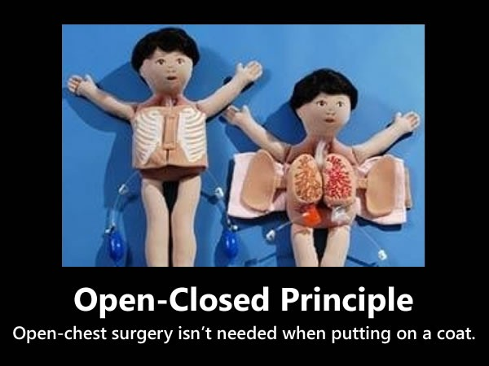
Agenda
Open Closed Principle
What is it?
Where did it come from?
Bertrand Meyer
Robert “Uncle Bob” Martin
Examples
I have brought some from home
Be thinking about other practical examples
Discussion (Q&A)

Slide 4
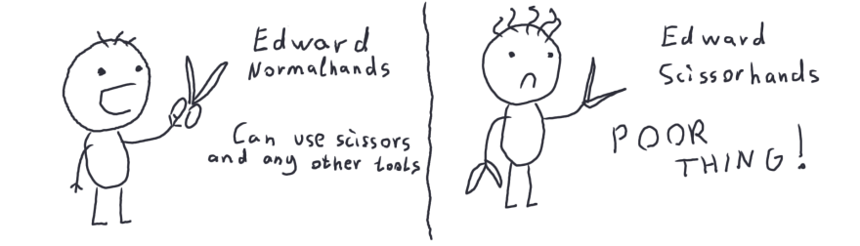
Ocp – Open closed principle
“You should be able to extend a classes behavior, without modifying it.” – Robert Martin
https://dev.to/satansdeer/openclosed-principle-86a

Slide 5
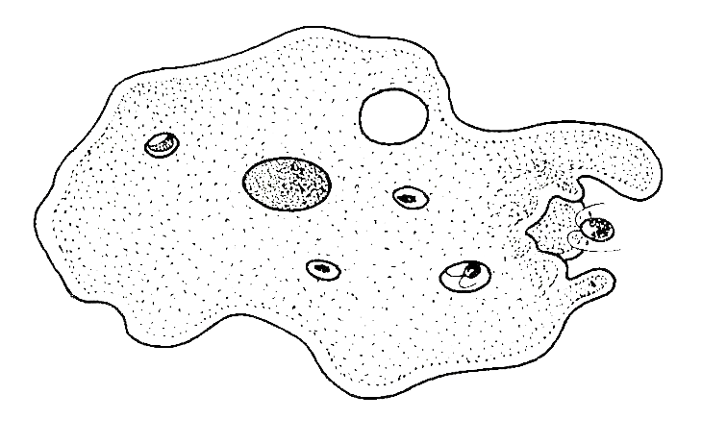
Ocp – Practical Definition
“Working code should only be written once.” – Me (& some XPers, probably)
Can I fix bugs?
What if the requirements change?
What if new algorithms are invented?
What if I don’t do this?
Should I guess when to use this rule?
I will give you answers this time!!!

Slide 6
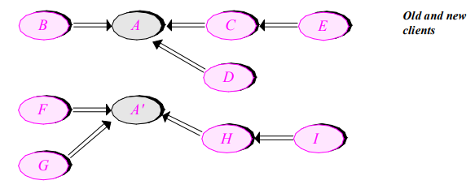
Modules should be both open and closed
A module is open if it can be expanded.
A module is closed if it is ready to be consumed by clients.
OOP was new when this was created.
What if a “module” A receives new clients that require new functionality?
Copy it? →
Object-Oriented Software Construction SECOND EDITION, Bertrand Meyer Chapter 3 Section 3 Five Principles

Slide 7
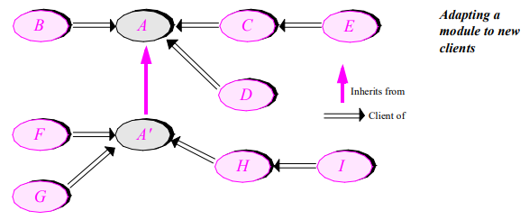

Open and closed?
How can A be closed (has clients) and be open (can be expanded)?
Let’s use inheritance.
A is still closed. A’, once completed, is closed.
Object-Oriented Software Construction SECOND EDITION, Bertrand Meyer Chapter 3 Section 3 Five Principles

Slide 8
miscellany
“If you can add additional functionality at no extra complication, do so.”
“This is not a way to address design flaws, let alone bugs.”
“If there is something wrong with a module, you should fix it – not leave the original as it is and try to correct the problem in a derived module [(Unless you don’t own the code.)]”
Object-Oriented Software Construction SECOND EDITION, Bertrand Meyer Chapter 3 Section 3 Five Principles

Slide 9
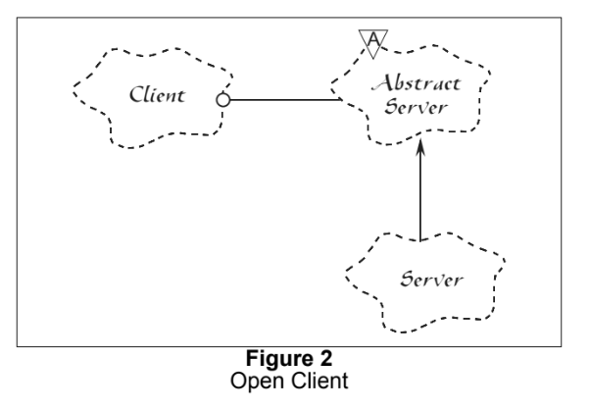
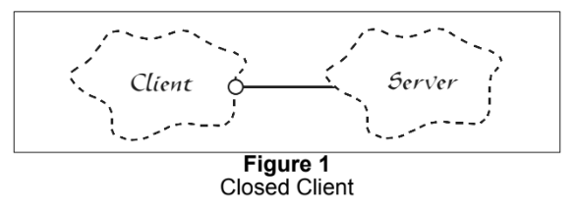
Open for extension; Closed for modification
Open for extension – Make the module behave in new/different ways as requirements change.
Closed for Modification – No one is allowed to make source code changes.
https://drive.google.com/file/d/0BwhCYaYDn8EgN2M5MTkwM2EtNWFkZC00ZTI3LWFjZTUtNTFhZGZiYmUzODc1/view

Slide 10
Getting closure
So what is closure?
Not the mathematical definition.
Not Clojure
Closed == done?
Who decides when it’s closed?
Close against developer modification and client modification (data/state).

Slide 11
More closure –Private member variables [fields]
When member variables (fields) change, every function that depends on those variables change.
Member methods are not closed to member variable changes; However we expect other classes are closed against changes to those variables.
We have a name for this: ENCAPSULATION!!!
If you have variables that are constant, you can make them public if they are read only.
Guarded Properties. [Visual Studio Snippet: propg + TAB TAB]

Slide 12
More closure – Global variables & Run time type IDENTIFICATION
Global Variables
Similar risks as with public member variables.
Singletons? Pattern or Antipattern? [Discussion]
Run Time Type Identification
Checking type at run time
You generally get exceptions when something goes wrong.
Checking types couple your logic and types. It is not closed against new types.

Slide 13
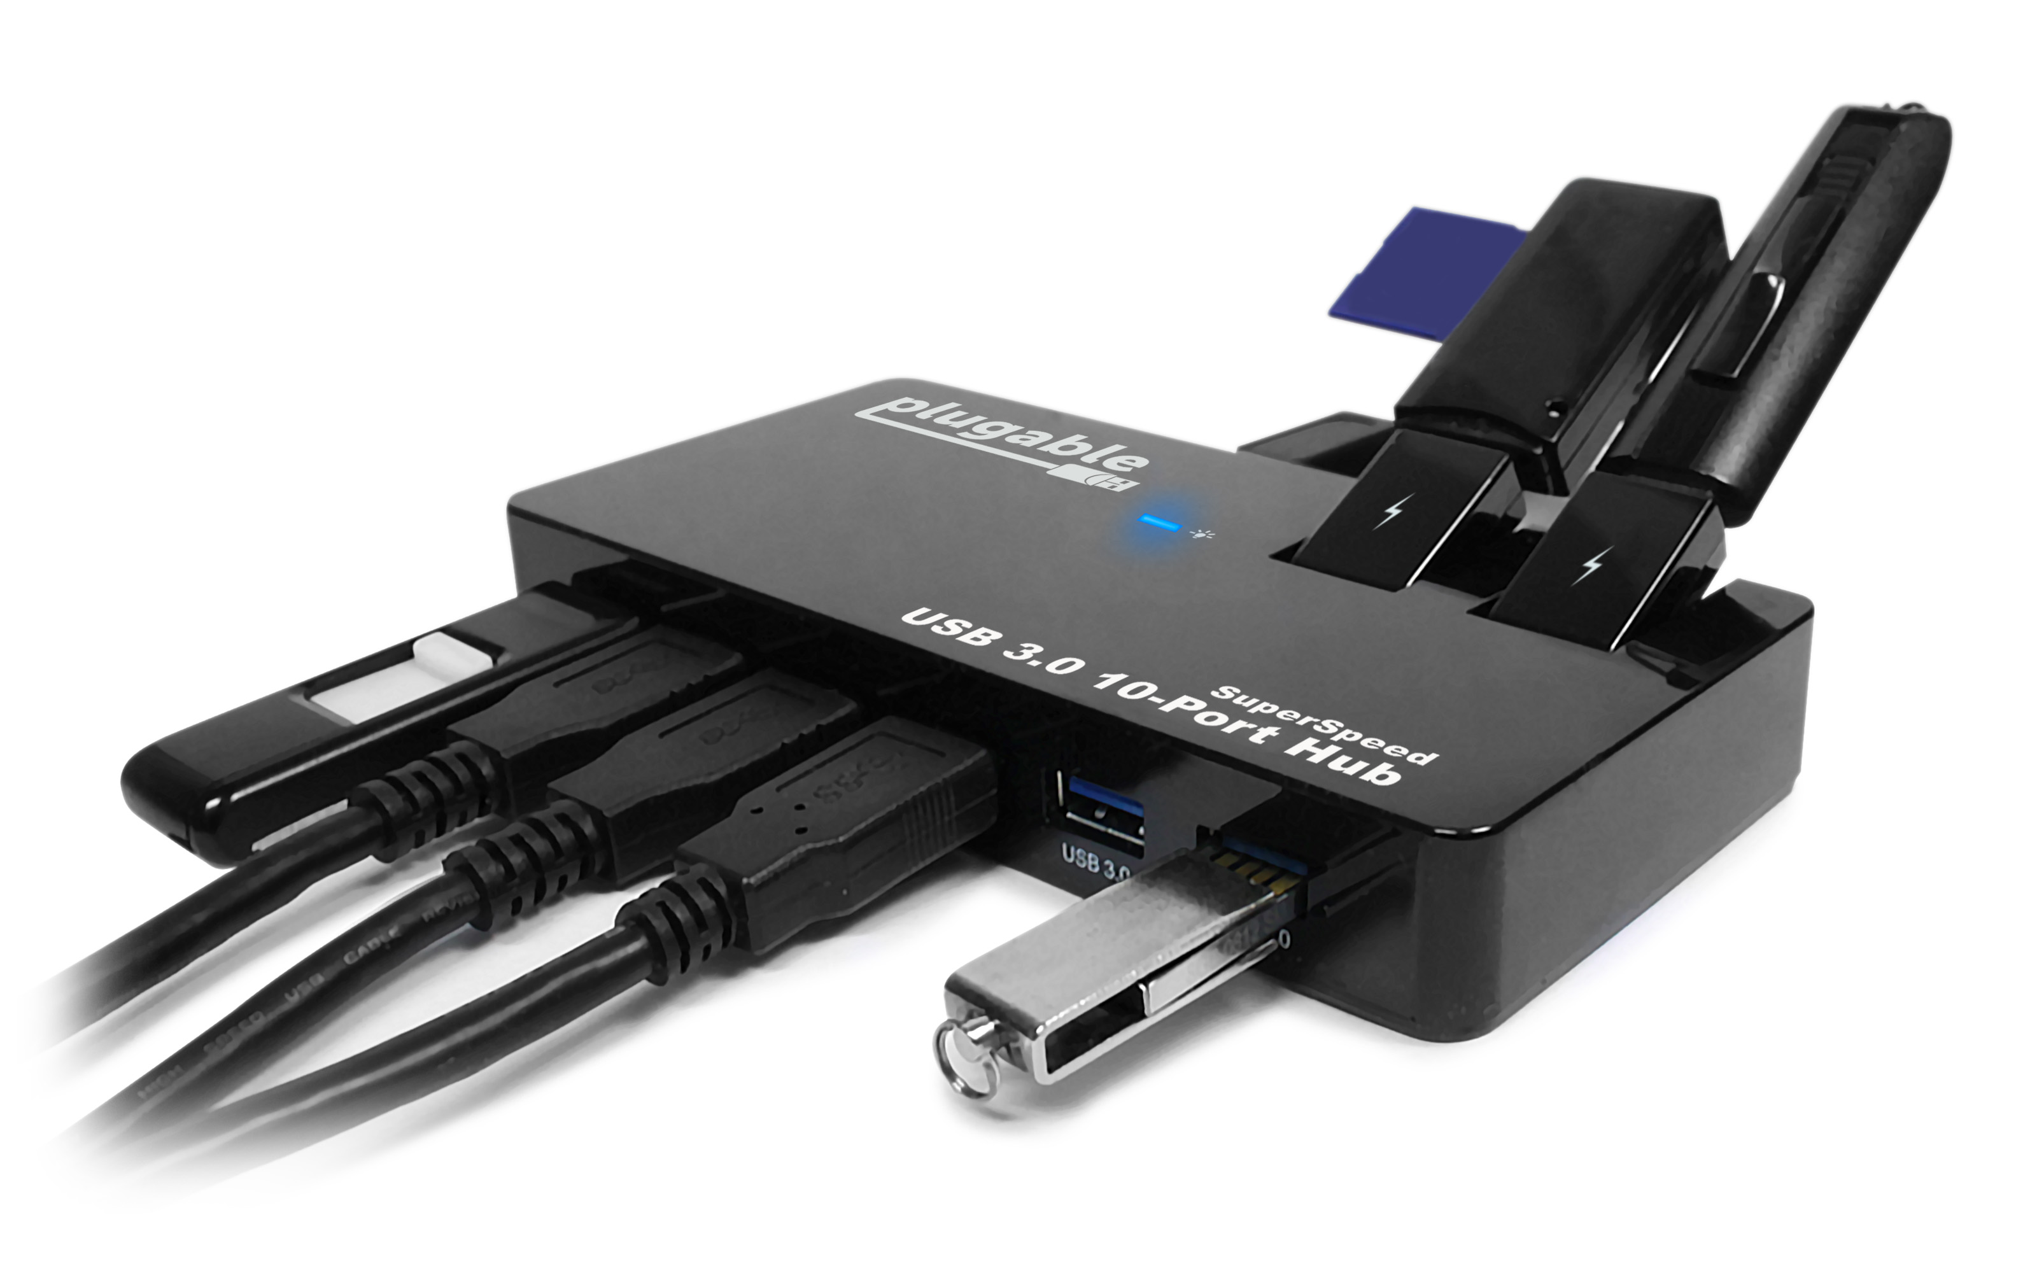
Plugin architecture
“… a strong plugin architecture is likely to be the most important aspect of future software systems.” – Robert Martin

Slide 14
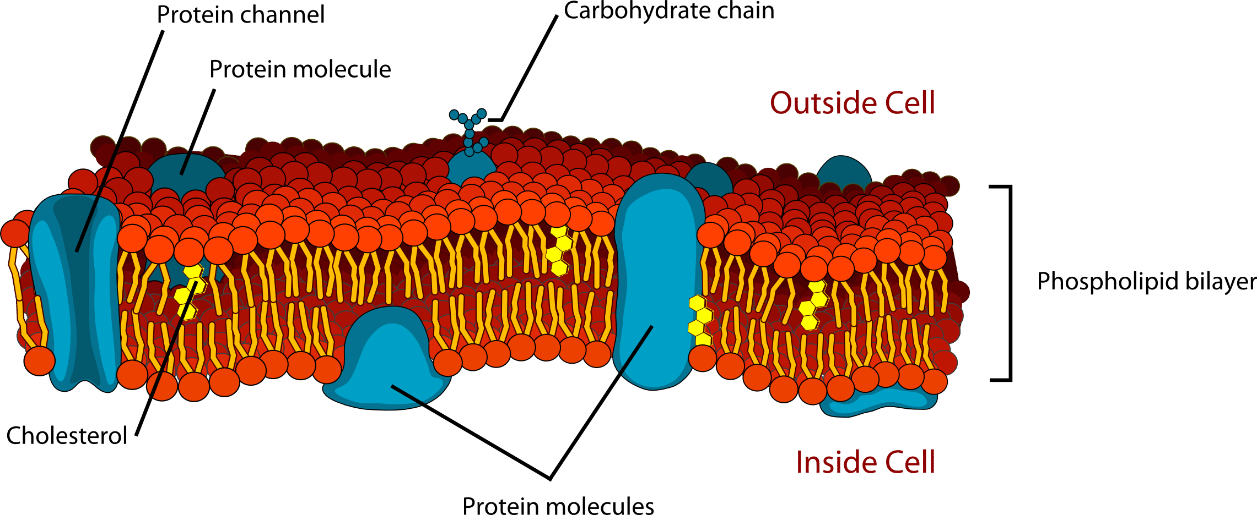
Biology metaphor
https://chem.libretexts.org/Courses/University_of_Kentucky/UK%3A_CHE_103_-_Chemistry_for_Allied_Health_(Soult)/Chapters/Chapter_14%3A_Biological_Molecules/14.3%3A_Phospholipids_in_Cell_Membranes

Slide 15
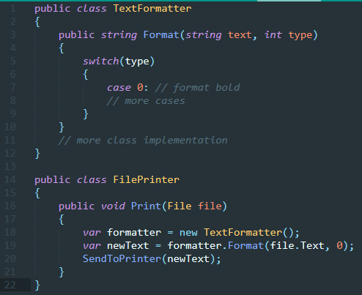
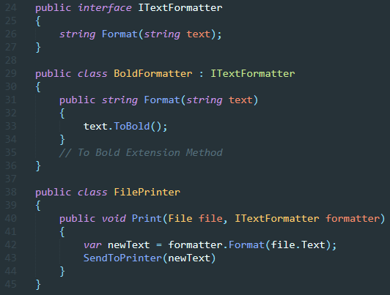
Ocp – simple example

Slide 16
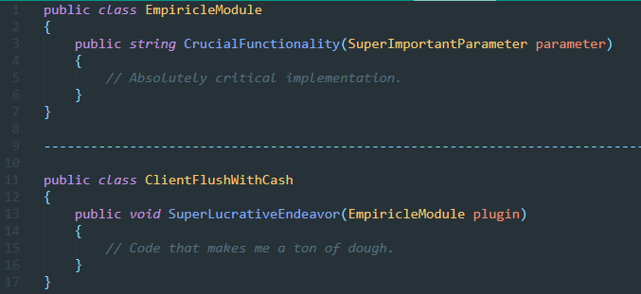
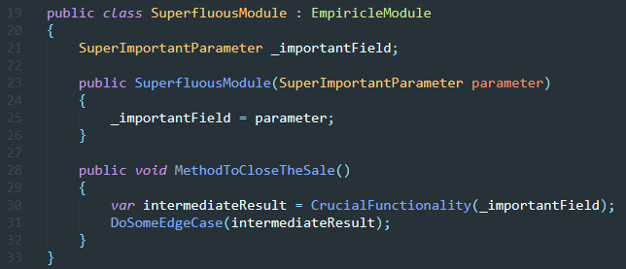
Open For Extension

Slide 17
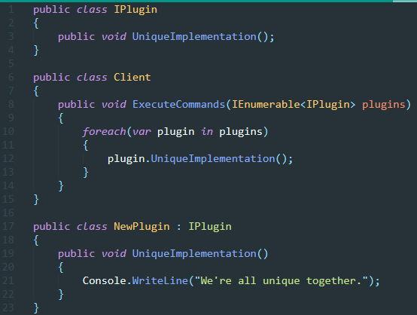
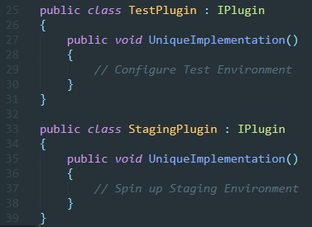
Plugin Architecture

Slide 18
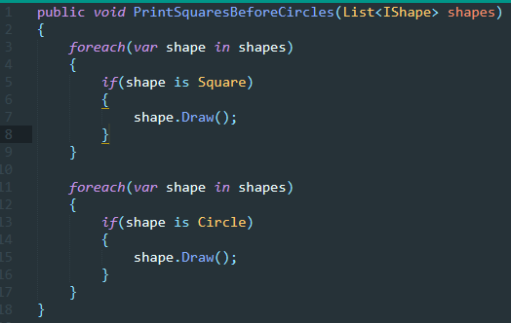
Pop Quiz - Is this method closed?

Slide 19
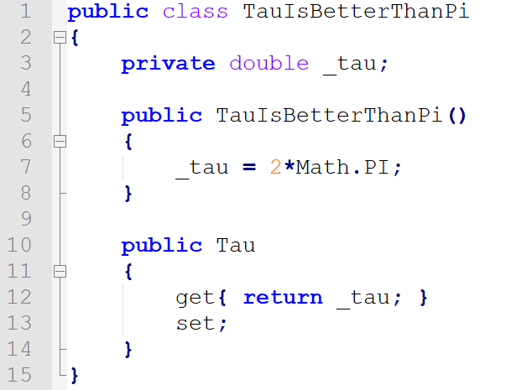
Pop Quiz – Is this class closed?

Slide 20
Summary
Open = Write new code to change functionality.
Closed = scope of functionality.
Use Encapsulation

Slide 21
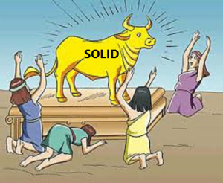
FIN
Q&A

